Slide 1
Review of ICT-based telecare systems and home care services for Ambient Assisted Living
Lengyel Zsolt

Slide 2
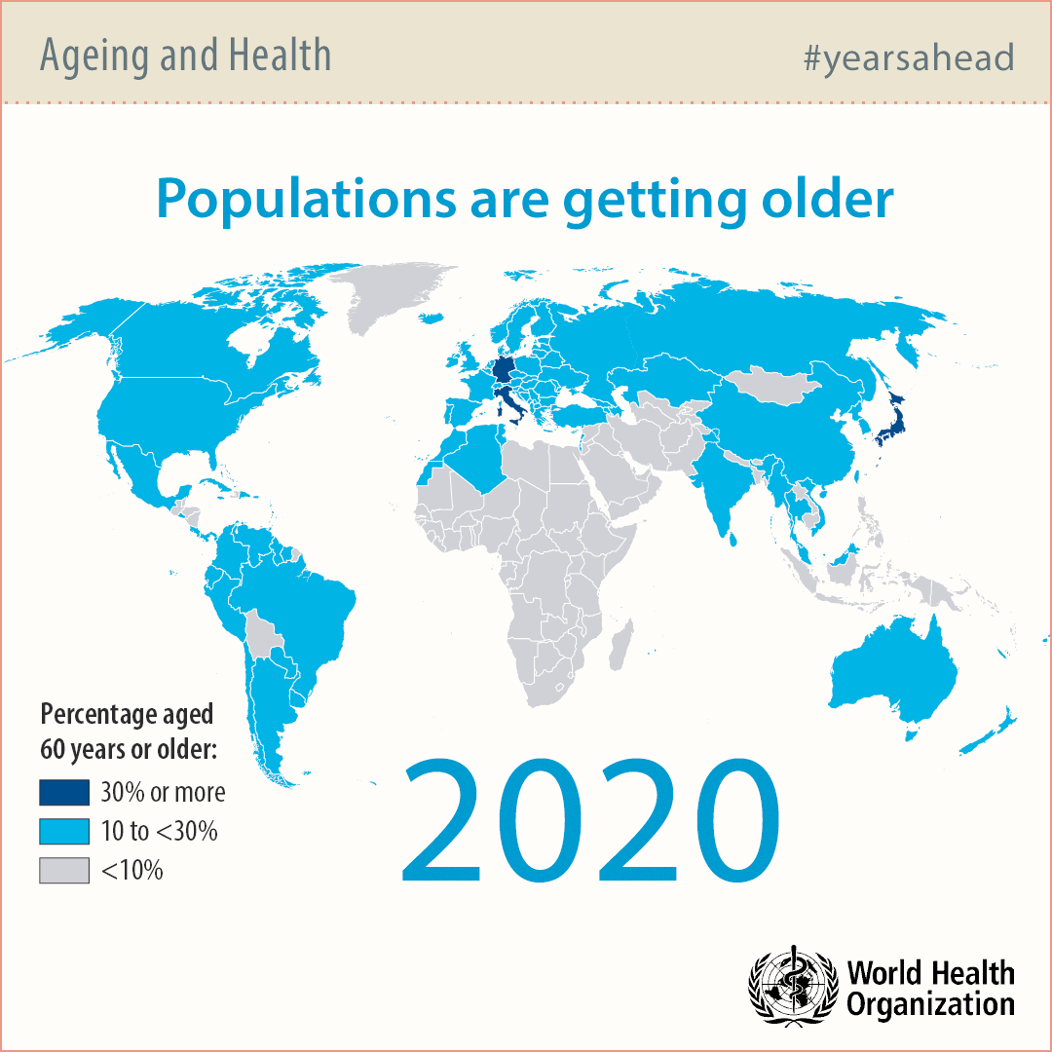
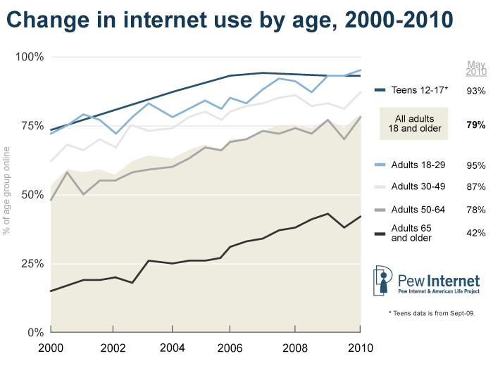

Slide 3
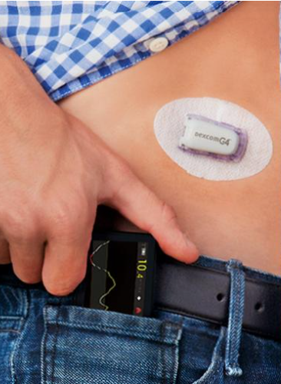
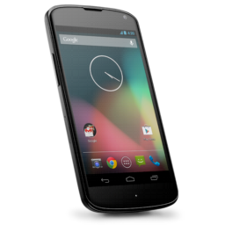
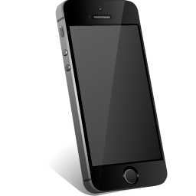
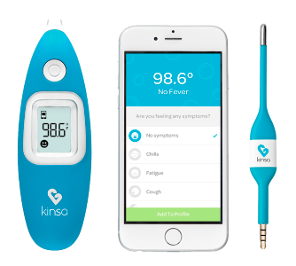
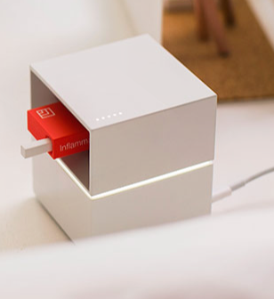
App
Device
Notes:
http://www.dexcom.com/hu-HU
https://cue.me/#inflammation

Slide 4
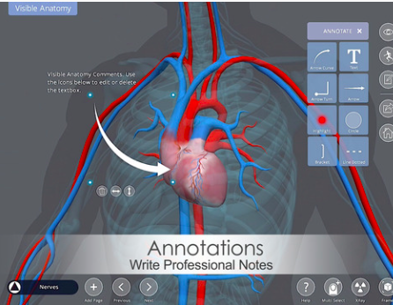
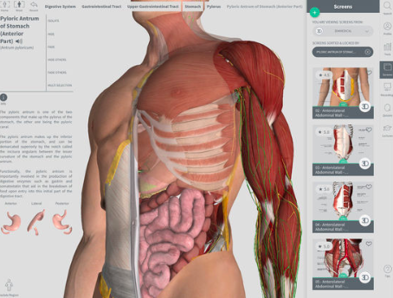
Apps
Educational
Visible Anatomy
By Eddie Quah
Complete Anatomy
By 3D4Medical.com, LLC

Slide 5
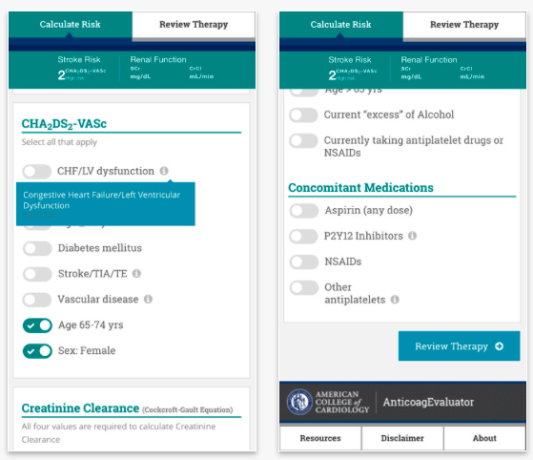
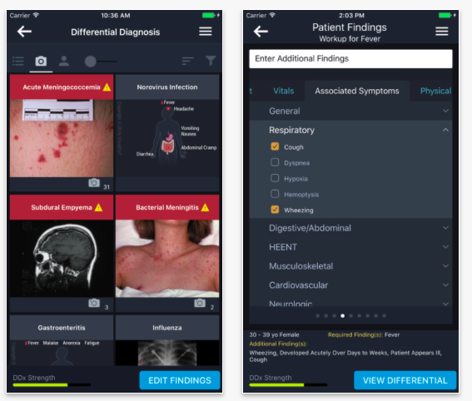
Apps
Diagnostic
AnticoagEvaluator
By American College of Cardiology
VisualDx
By Logical Images
Notes:
https://itunes.apple.com/us/app/anticoagevaluator/id609795286?mt=8
https://itunes.apple.com/us/app/visualdx/id348177521?mt=8

Slide 6
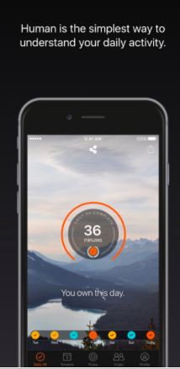
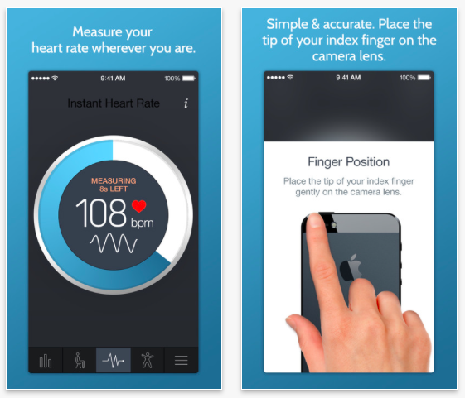
Apps
Measuring
Human - Activity Tracker
By Human
Instant Heart Rate+: Heart Rate & Pulse Monitor
By Azumio Inc.
Notes:
https://itunes.apple.com/us/app/visualdx/id348177521?mt=8
https://itunes.apple.com/us/app/human-activity-tracker/id692721875?mt=8

Slide 7
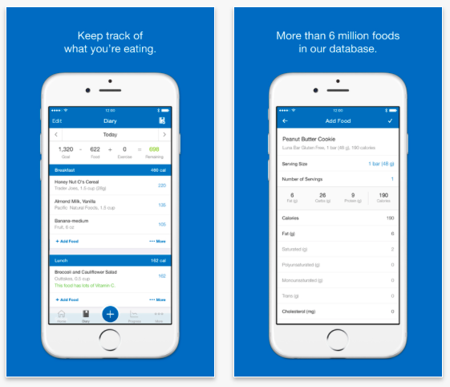
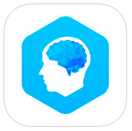
Apps
Games for mental health
Apps
Lumosity - Brain Training
By Lumos Labs, Inc.
Tracker
Elevate - Brain Training and Games
By Elevate, Inc.
Calorie Counter & Diet Tracker
By MyFitnessPal.com

Slide 8
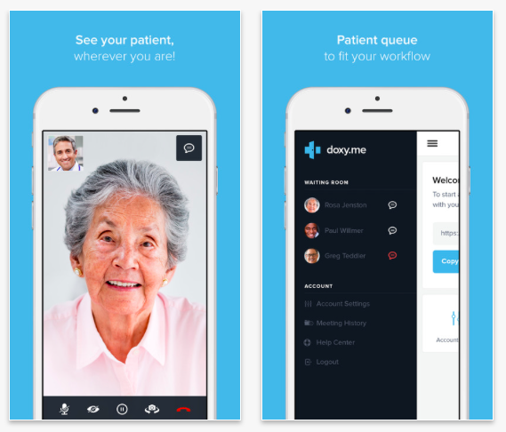
Apps
Patient-Doctor
https://www.talkspace.com
Doxy.me - Simple and Secure Telemedicine App
By Doxy.me LLC

Slide 9
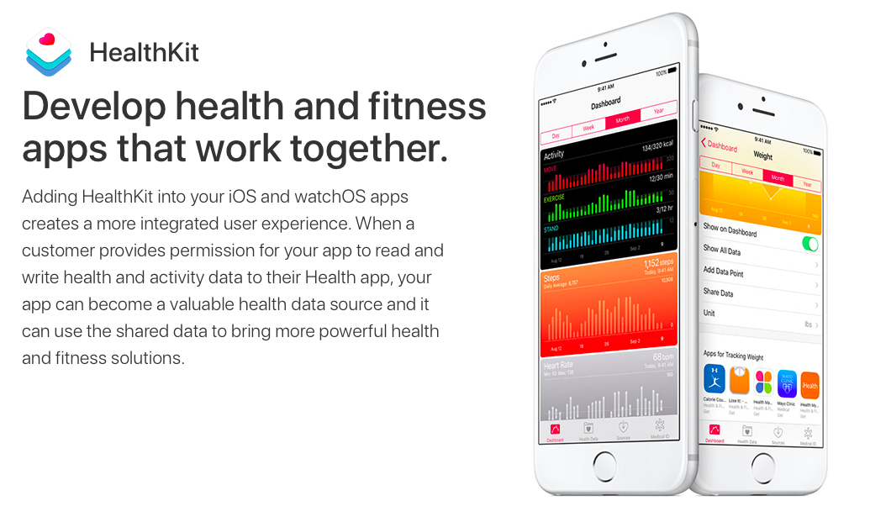
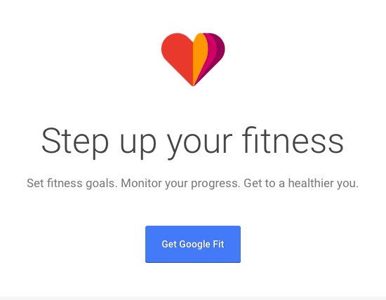
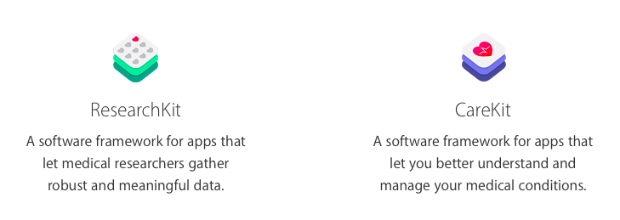
Apps
Frameworks/API’s for health

Slide 10
Apps
General

Slide 11
Devices
Standalone (no app required)
Wearable
Not wearable
https://cue.me

Slide 12
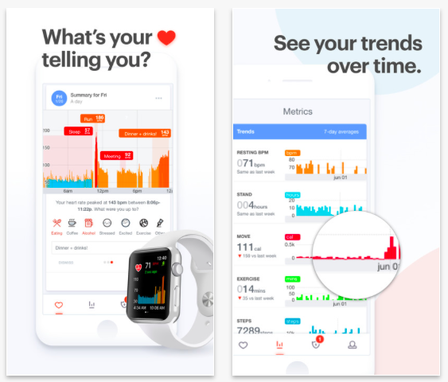
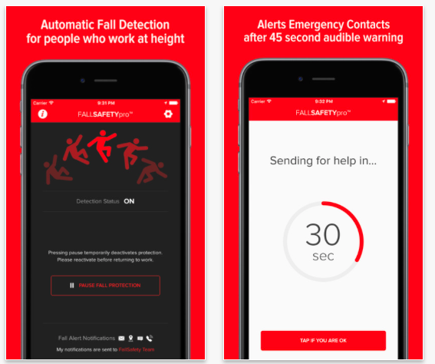
Devices
Cardiogram - Watch your Heart Rate & Health
By Cardiogram, Inc.
FallSafety Pro – Fall Detection & Man Down Alarm
By Tidyware, LLC

Slide 13
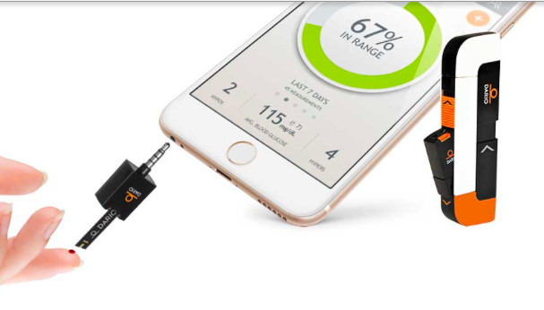
Devices
Dario Blood Glucose
Management System
Notes:
http://mydario.com
http://www.ebay.com/itm/DS18-Waterproof-GPS-Tracker-SOS-Call-Kids-Children-Smart-Watch-For-Android-iOS/391760592007?_trksid=p2047675.c100005.m1851&_trkparms=aid%3D222007%26algo%3DSIM.MBE%26ao%3D2%26asc%3D41375%26meid%3D601d05237023466397b61788f8d03f6b%26pid%3D100005%26rk%3D6%26rkt%3D6%26sd%3D172719933757

Slide 14
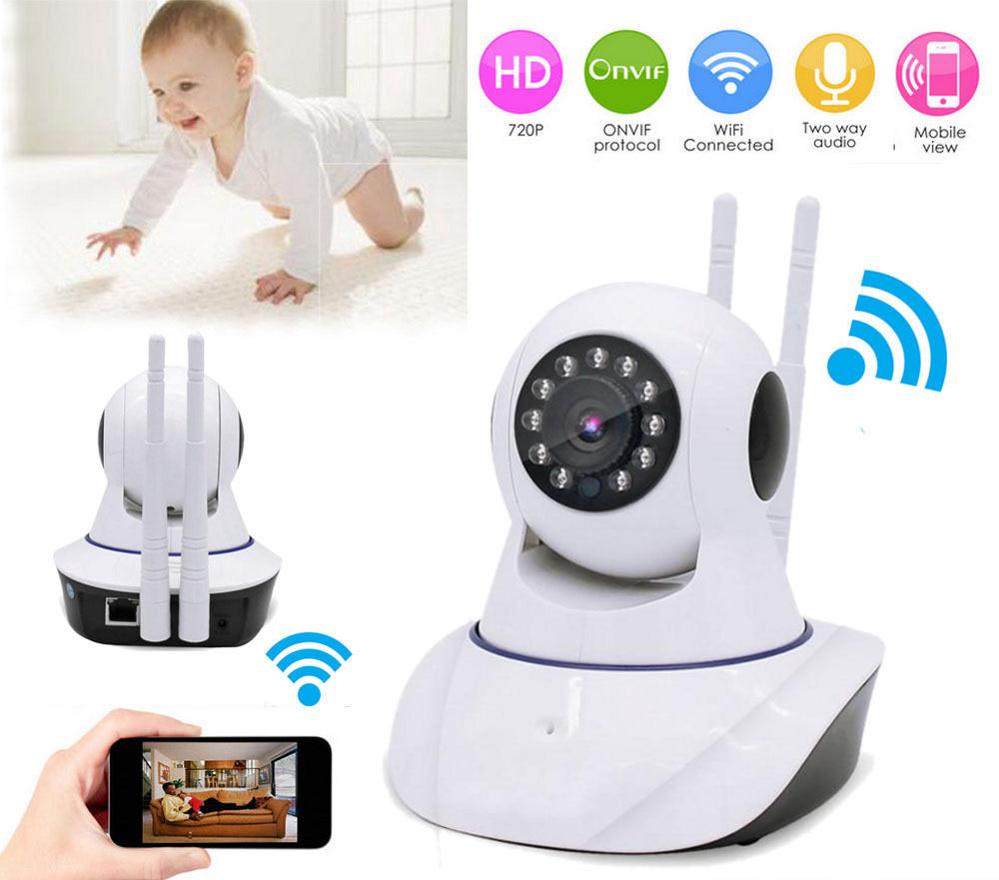
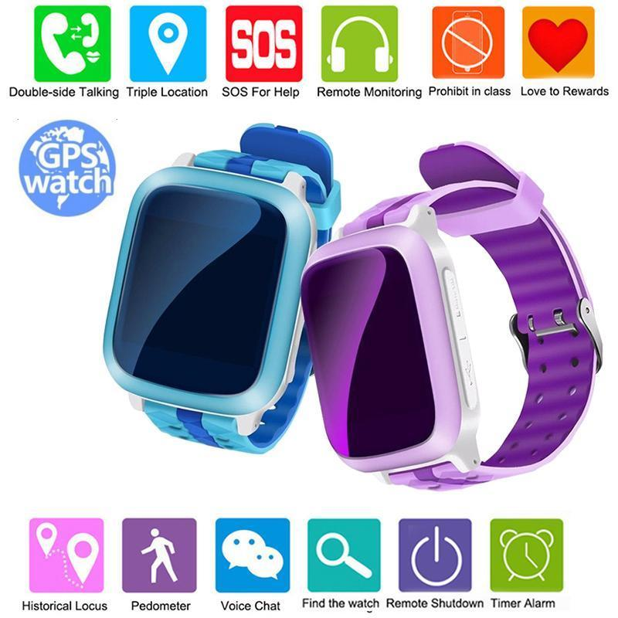
Devices
35 EUR
25 EUR
DS18 Waterproof GPS Tracker SOS Call Kids Children Smart Watch For Android iOS

Slide 15
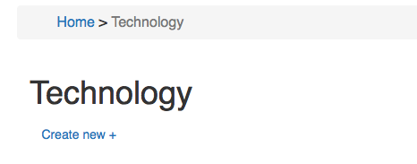
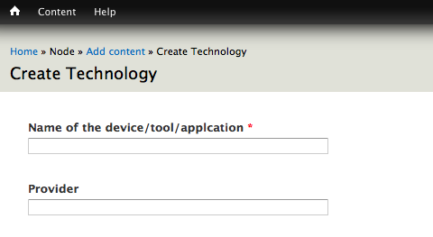

Slide 16
Thank You for your attention

